Slide 1
FAcebox
Slowing down Social media.

Slide 2
Introduction
Slowing down Social media.
Does obstructing the expected immediacy of technology affordances affect the quality and quantity of social media posts and therefore improve the qualitative nature of those posts?
The project goal was to create a mechanism from which social media posts, particularly Facebook could be generated. The aim was to add a deliberateness to posting that demonstrated a greater intrinsic value than the current Facebook posting, comments and shares.
(Statista, 2018)

Slide 3
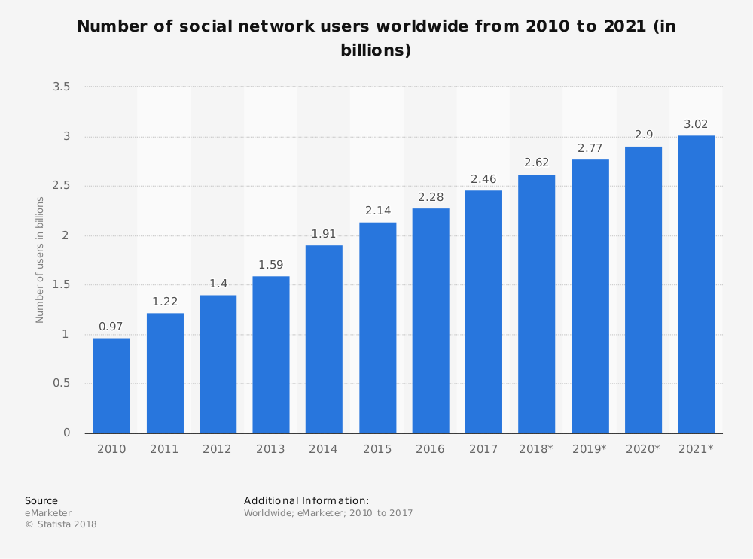
Context
Social network penetration worldwide is ever-increasing
Globa Facebook user base is predicted to
rise to 65% in 2020 (Statista, 2018)
(Statista, 2018)

Slide 4
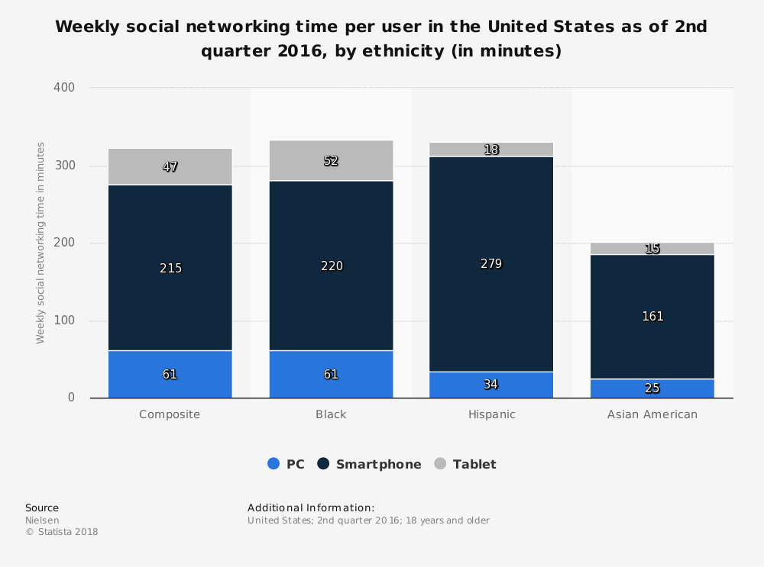
Context 2
Smartphones are the most popular format for social media access
Young adults, the people with high levels of social media use feel a greater sense social isolation (Primack et al. 2017)
(Statista, 2018)

Slide 5
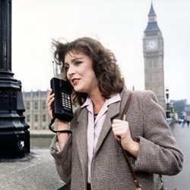
Background (techhology)
The world’s first mobile phone call was carried out in Aug 1973 by Martin Cooper, a senior engineer at Motorola, the mobile he used was a prototype that weighed 1.1Kg.
With the growth in mobile text and quick photo sharing came the diminishing breadth of macro level news stories in favour of smaller more localised news feeds based on personal experience or social sharing.
One of the offsets of constant connectivity is, always being available and social media instant accessibility.
BT Pearl Mobile 1986 (BT Pearl Mobile Phone 1986, 2018)

Slide 6

Background (FoMO)
FoMO is characterized by the desire to stay continually connected with what others are doing. (Przybylski et al. 2013)
Self Determination Theory - fulfils three basic psychological needs (Kirsh, 2012.p84)
Self Esteem
Positive Emotions
Vitality
Imagined communities are formed through other psychological needs too such as autonomy, competence, and relatedness (Ryan and Deci, 2000)
(Fomo, Anon, 2018)

Slide 7

the value of digital social media information
Does the social media medium offer any intrinsic value to society?
(National Archives Logo, 2018)

Slide 8
Affordances & the Slow Movement
“..technological artefacts are socially shaped” (Hutchby, 2001.pg 441), but can be subverted.
“Doing everything as well as possible, instead of as fast as possible. It’s about quality over quantity in everything from work to food to parenting” (Honoré, 2009
Affordance: action possibilities that are readily perceivable by an actor (Donald Norman

Slide 9
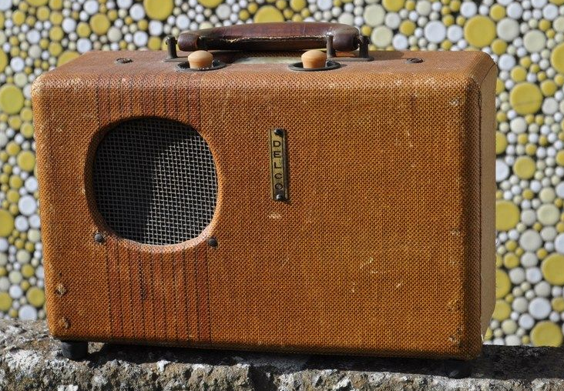
Concepts for the device
Build an unique object that could interact with Facebook in a meaningful way, that could test the hypnosis’s posed within the enterprise (Does obstructing the expected immediacy of technology affordances affect the quality and quantity of social media posts and therefore improve the qualitative nature of those posts?)
Device constructed should be fully mobile
Re-appropriate a traditional analogue communication format
Should be used as the sole Facebook device for 7days
Endeavour to continue Facebook enjoyment
Build a website to reflect to device in use
and define the project aims
Delco radio fitted with Bluetooth (ke4mcl, 2018)

Slide 10
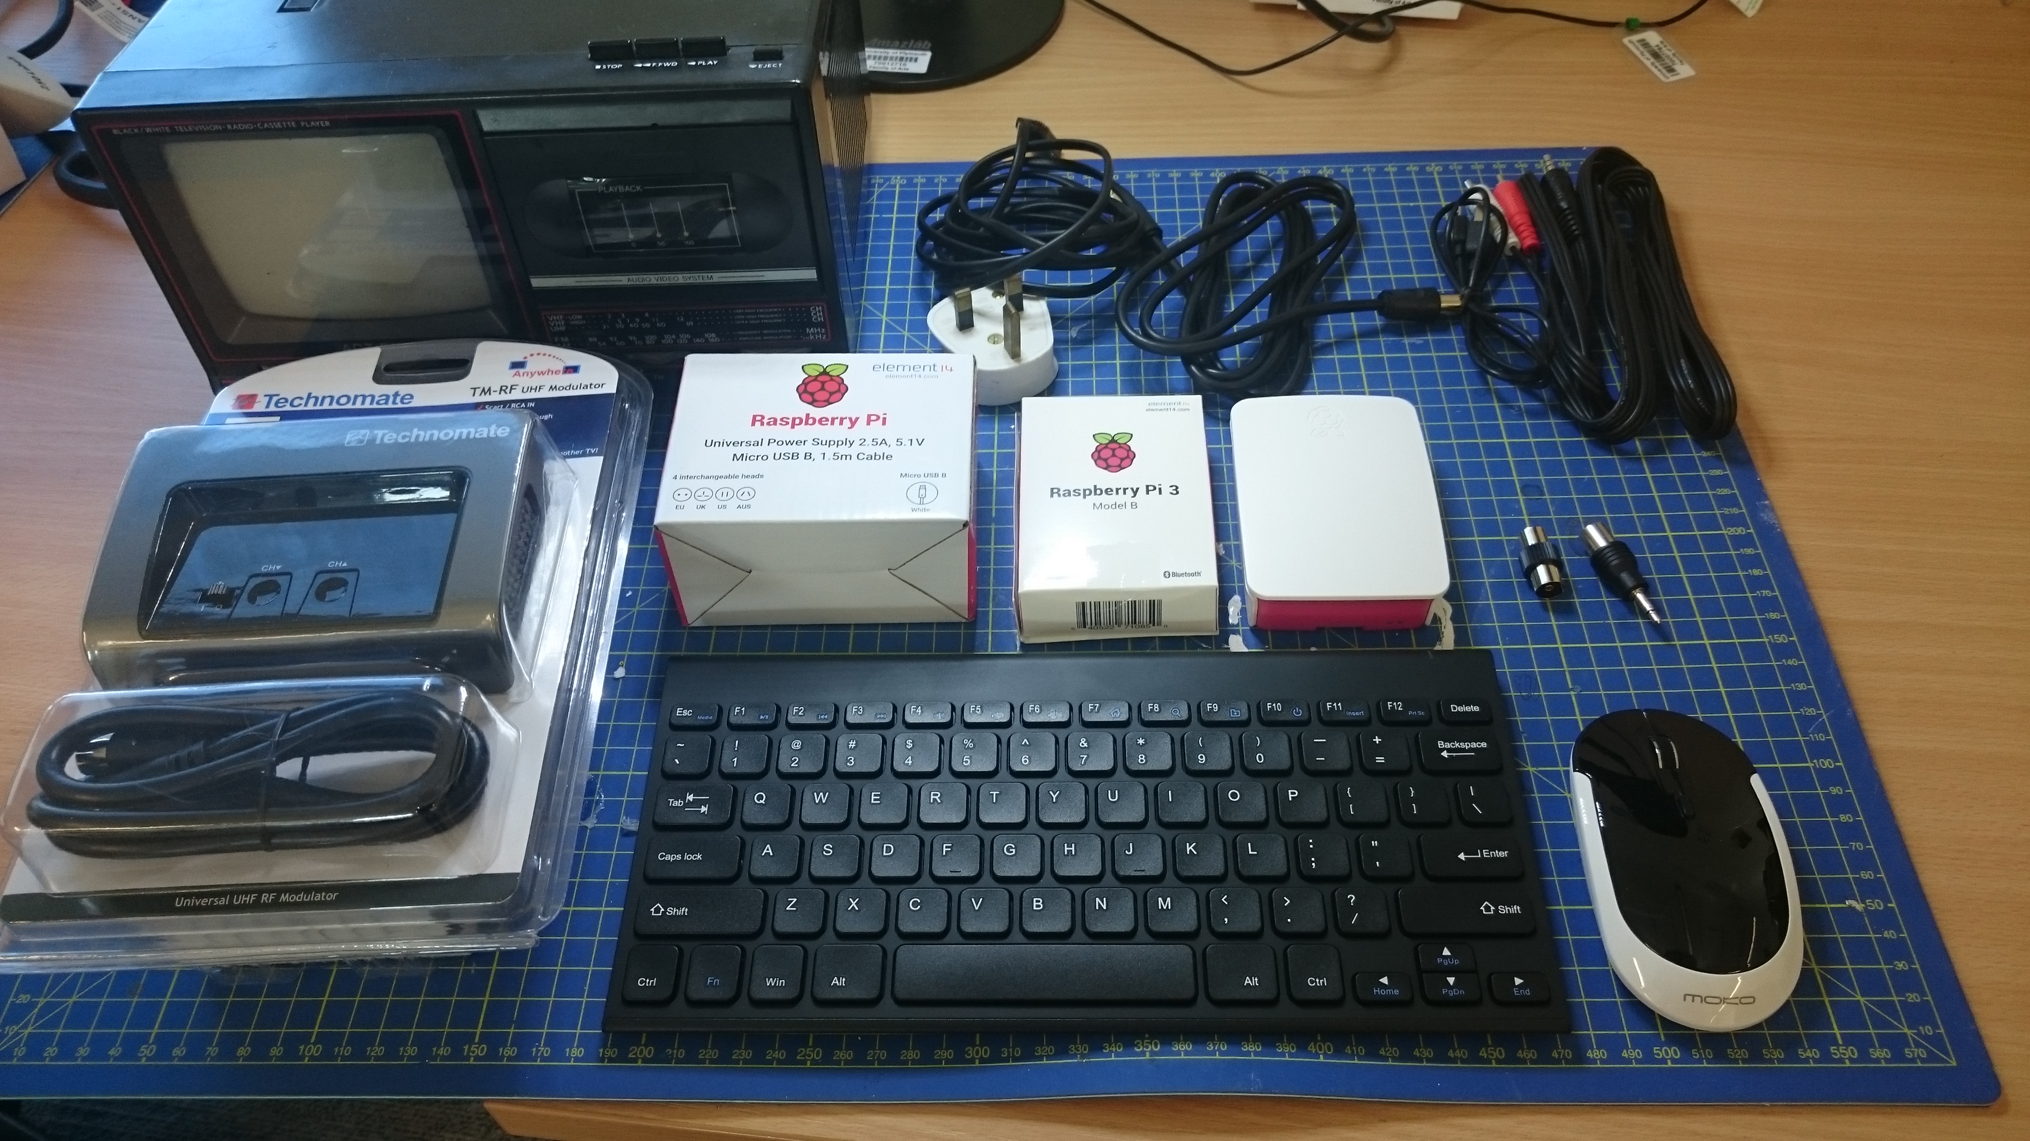
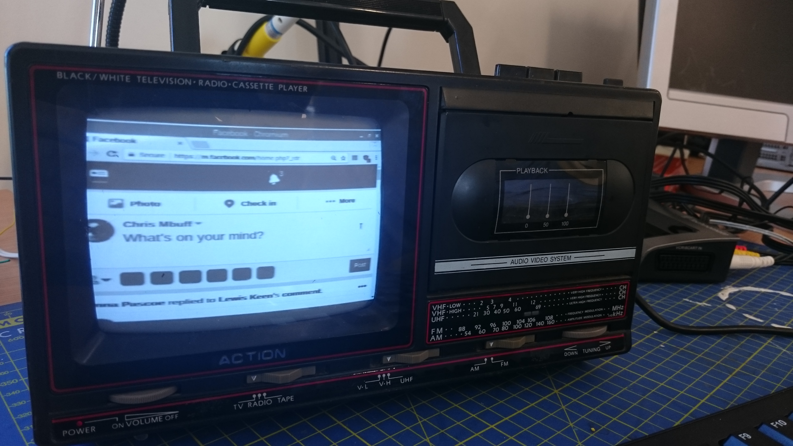
Early protoyping
Trial using B&W TV with Raspberry Pi3
Some of the technologies tested here were later used in the final piece

Slide 11
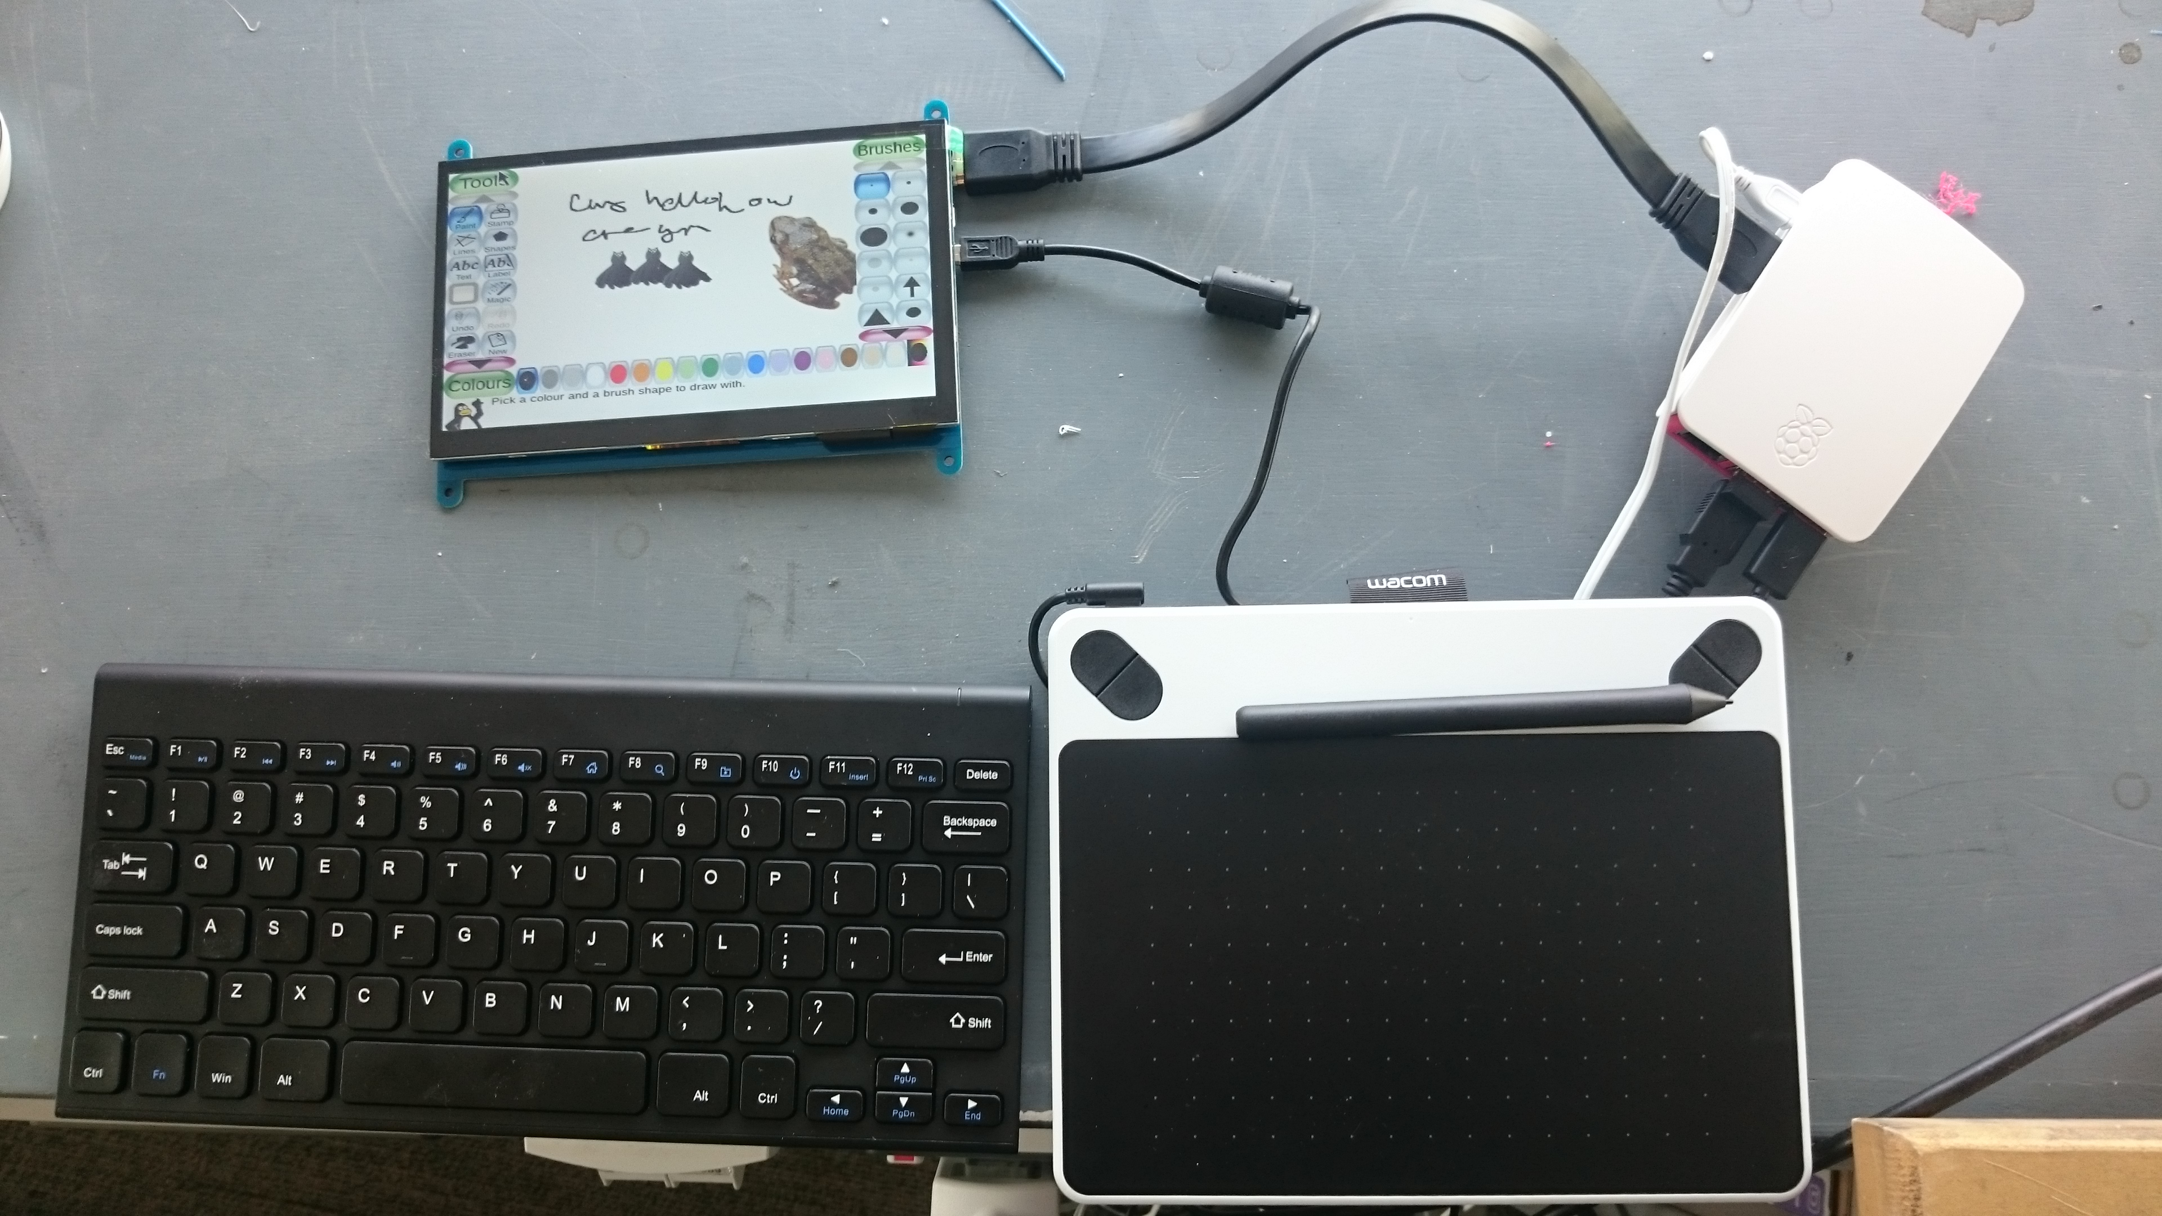
Testing the Format / Hand drawn messages
Pi 3, RAVPower 22000mAh Power Bank 5.8A Output ,Elecrow Monitor Display IPS Screen -7 Inch 1024X600 HD TFT ,Wacom Intuos Draw graphics tablet LB-Link USB Wi-Fi Module with Antenna, Parts from Asda own brand rechargeable stereo speaker
Tests were carried out to check
the components were compatible
and capable of running the
Pinta drawing software, Chromium
and Raspbian Stretch OS in a variety of
locations

Slide 12
Designing the appartaus

Slide 13
Problems Encountered

Slide 14
Using the Device for a week

Slide 15
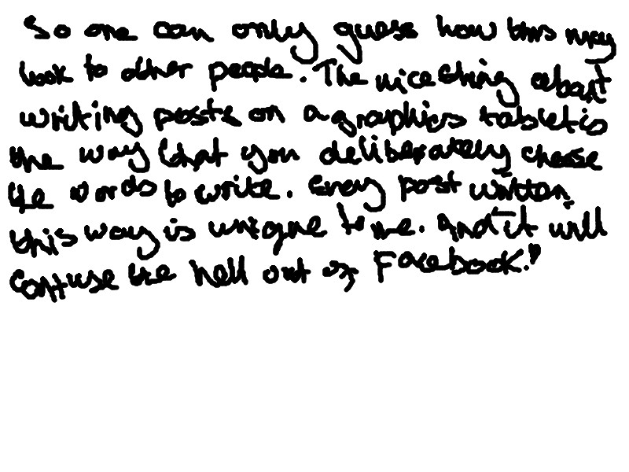
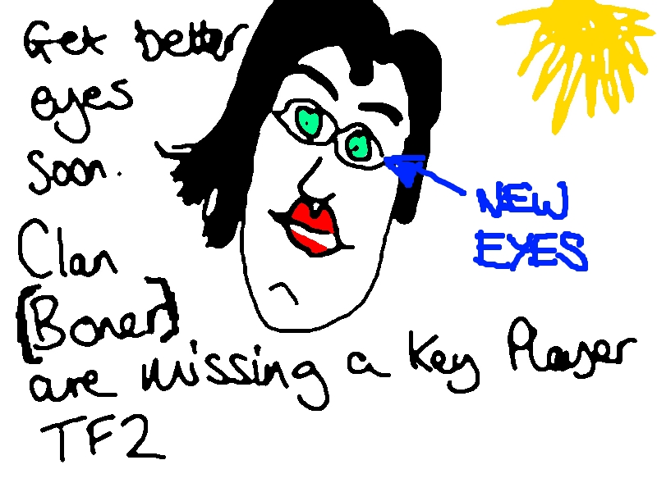
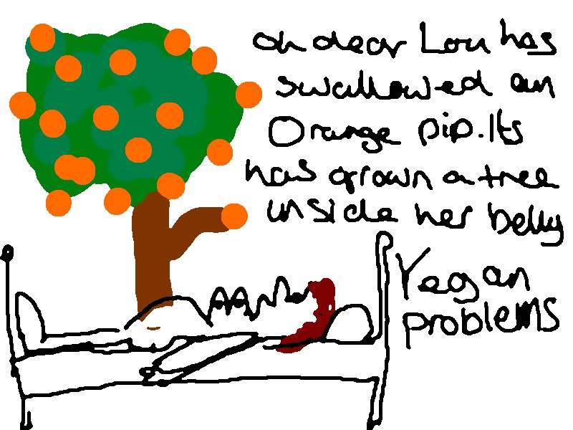
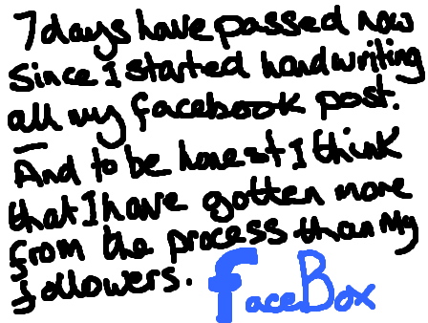

Slide 16
Data Gathered

Slide 17
Data Gathered

Slide 18
Analysis

Slide 19
Conclusion

